Slide 1

Azure Service Bus
The Architect’s Cut
Patterns
Features
Architecture
Internals
Clemens Vasters
Chief Messenger, @clemensv

Slide 2
Agenda
“What is Azure Service Bus?”
Patterns and Features
JMS 2.0, Azure SDKs, product-neutral AMQP stacks
Deep(er) Dive
Clusters and Namespaces
Networking Capabilities
Authorization Models
Log Storage
Message Broker Compute Model
Q&A

Slide 3
What is Azure Service Bus?
Platform-as-a-Service Queue and PubSub Message Broker
Fully managed: You use the features, Azure deals with everything else
JMS 2.0 and AMQP 1.0 standards compliant
Polyglot Azure SDK and cross-platform client support
Industry-leading reliability and availability

Slide 4
SKUs and Pricing
Azure Service Bus Standard:
Very cheap consumption-based pricing model
$9.72 monthly base charge per Azure subscription for up to 50 namespaces
13M ops/month free, 13-100M ops/month $0.80 per M, 100-2500 M ops/month $0.50 per M, 2500M+ ops/month $0.20 per M.
Service Bus Basic is a queues-only limited version of Standard, $0.05 per M ops.
Shared-resources model
Azure SDK, AMQP clients, supports JMS 1.1/2.0 queue API for send and receive.
Azure Service Bus Premium:
Capacity-based pricing model
$0.928/hour or $677.08/month per Messaging Unit
No further per-operation charges
Isolated-resources model
Azure SDK, AMQP clients, supports the full JMS 2.0 feature set
As you‘ll learn today, these are different service implementations behind the scenes

Slide 5


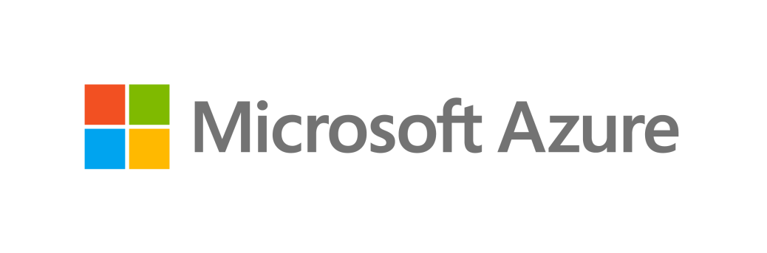
You're running a JMS 2.0 broker cluster in your own datacenter? IBM? TIBCO? Red Hat? VMWare?
Azure Service Bus
Azure Service Bus is
more reliable and dependable with higher 24/365 uptime (no service windows, no weekend downtime)
far less costly to own (no initial/recurring licensing fees)
far less costly to operate (fully managed, no hardware)
just a quick network hop away from your existing workloads
easy to integrate into your network via VPN Gateway or Express Route

Slide 6
Service Bus Namespaces: Virtual Brokers
Public IP
Vnet
A
Vnet
B1
Vnet
B2
DNS
Networking
Service Bus Platform Host
Firewall with IP Filters
Firewall
yournamespace [.servicebus.windows.net]
othernamespace [.servicebus.windows.net]
orders
warehouses/AB/siteA
xyz
invoices
warehouses/AB/siteB
abc
deliveries
warehouses/CD/siteA
klm
production
warehouses/CD/siteB
bmg
Names of queues and topics can be a flat list
Names of queues and topics can also form a hierarchy. Entities must be at the leaves.
Azure Resource Manager

Slide 7

Service Bus Queues (I)
There can be up to 5000 concurrently competing consumers per entity.
First come, first served.
Send: Add sequence number & server timestamp, write/flush to log, then report as accepted
Sequential log, ordered by sequence number (order of arrival)
Seq no 741
Acquired messages are locked exclusively to the acquirer (consumer) until they are settled or the lock expires*
Consumer
Producer
Seq no 744
Seq no 743
Seq no 742
Seq no 741
Seq no 740
transfer
Consumer tells the broker the state of the message. accepted: Accepted and handled. Can be removed, must not be redelivered. released: Not handled. Should be redelivered.
rejected: Not handled. Considered defective. Must not be redelivered.
available
available
available
acquired
deleted
accept
Consumer
Max message size: Std: Up to 1MB Prm: Up to 100 MB
Max queue size: Up to 80GB
Oldest available message is the next to be acquired and delivered. In Premium, using JMS, consumers can skip to the first available message that fits a certain criterion (message selector) without head-of-line blocking.
transfer
Seq no 740
* locks always have a timeout and instantly expire when the connection breaks. (As of 3/22, might change ;)

Slide 8
Service Bus Queues (II)
Every queue and topic subscription has its own dead-letter subqueue: myqueue/$deadletterqueue
All messages that cannot be delivered (released more often than permitted) or have been rejected and optionally those that have expired and put into the dead-letter queue and remain there.
The reason for why and from where the message has been moved is remarked in the DeadLetterReason, DeadLetterErrorDescription, and DeadLetterSource properties.
The deadletter queue is otherwise a normal queue and can be used with the normal receiver clients.
Dead-letter Queue
Seq no 521
Seq no 671
available
available
Producer
Seq no 744
Seq no 743
Seq no 742
Seq no 741
Seq no 740
scheduled
deferred
available
acquired
deleted
Scheduled messages have been accepted and stored in the queue log, but they are made available for delivery only after ScheduledTimeUtc.
Scheduled messages can be canceled using the sequence number returned by the scheduling API.
Scheduled messages are re-sequenced and re-timestamped as their state changes to available.
Deferred messages have been delivered to a consumer at least once and the consumer has decided to set them aside instead of settling them.
Deferred messages remain in the log but are not eligible for delivery until they are restored into the available state.
Deferral is a special feature for state workflow engines that expect to handle messages in a particular sequence.

Slide 9
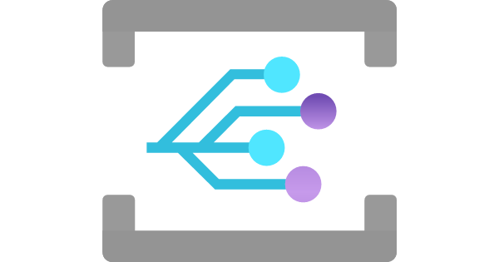

Service Bus Queues (III)
Processing Function
Microsoft.ServiceBus. ActiveMessagesAvailableWithNoListeners
Microsoft.ServiceBus. ActiveMessagesAvailablePeriodicNotifications
Producer
Seq no 742
available
Handlers for very quiet queues with minimal throughput can "scale to zero", and then be triggered by those events and yet process the message reliably.
For each entity, Service Bus raises events into Event Grid when a queue has active messages, both periodically and when there are no current receivers.

Slide 10
Service Bus Queues – Sessions
Sessions are unlimited, unbounded, ordered sequences of messages that are all labeled with the same SessionId. Using sessions requires a session-enabled queue or topic subscription.
Consumers acquire exclusive locks on the entire session and all messages belonging to it.
An active session behaves like an independent queue, without messages from other sessions blocking progress (no "head of line blocking")
Seq no 740
deleted
Producer
Seq no 743
Seq no 741
Consumer
SessionId "123"
123
available
acquired
The owning consumer of a session has read/write access to the session state that the broker optionally maintains. Session state can hold data up to the max size of a message permitted for the queue.
When a new consumer acquires the session, it can therefore access all info left by a prior consumer related to processing the session.
Built for long-running workflow processes.
Seq no 744
Seq no 742
Consumer
SessionId "563"
563
available
available
A single queue can maintain hundreds of thousands of sessions and thus logical sub-queues.

Slide 11
Service Bus Queues – Tx
A transactional operation can send messages to any number of output queues or topics as a result of the transactional work. Sends are held until the transaction succeeds.
Service Bus transactions are a reliability anchor for performing high-value work in the cloud. Settling an input message of a job and sending resulting outputs of the job jointly suceeds or fails (with retry in the latter case).
Transaction Scope
Seq no 741
Seq no 8152
Producer
Seq no 744
Seq no 743
Seq no 742
Seq no 741
Consumer
acquired
scheduled
deferred
available
acquired
Seq no 9211
Transactions form around a "lead queue" from which the input message for the transactional work was acquired. Only one receiving queue can be enlisted in a transaction. Sessions are supported.
acquired
All settlement operations on the lead source queue are transactional: accepting (complete), releasing, rejecting (deadletter), deferral, session state ops.

Slide 12
Service Bus Topics
For consumers, subscription queues have all features of queues, including a dead-letter queue. They can also support sessions.
Actions can add, remove, and edit all application message properties and system properties like TimeToLive or SessionId.
One subscription can have up to 2000 (!) rules. Each filter match yields a copy of the tested message.
Correlation filters match properties against values ("equals").
SQL filters allow WHERE-condition-style SQL expressions against the app and platform message properties. sys.To LIKE 'region/DE/shops/%' AND subject='catalogUpdate'
Filter Action
Filter Action
Producer
Topic
Service Bus Topics are named multicast distribution points for messages.
Subscriptions are durable queues bound to topics through a collection of selection rules.
The $default rule selects all messages into the sub's queue
Filter
$default
JMS clients can use shared, unshared, durable and volatile subscriptions, with JMS-compliant SQL message selectors.
true

Slide 13
SDK Support: JMS 2.0 Provider
Azure Service Bus is fully conformant with Java JMS 2.0 (Jakarta Messaging)
Topic topic = session.createTopic(dest.toString());
MessageProducer sender = session.createProducer(dest);
TopicSubscriber topicSubscriber1 = session.createDurableSubscriber(topic, sub1Name);
TopicSubscriber topicSubscriber2 = session.createDurableSubscriber(topic, sub2Name, "JMSCorrelationID='5'", false);
MessageConsumer topicSubscriber3 = session.createSharedDurableConsumer(topic, sub3Name, "JMSCorrelationID='5'");
Queues
Topics
JMS Message Selectors
Shared Durable Subscriptions
Unshared Durable Subscriptions
Shared Volatile Subscriptions
Unshared Volatile Subscriptions
Queue Browser
Queue Message Selectors
Temporary Queues
Temporary Topics
JMS Transactions
TextMessage message = session.createTextMessage("Text!");
message.setJMSCorrelationID(Integer.toString(i));
sender.send(message, DELIVERY_MODE, Message.DEFAULT_PRIORITY, Message.DEFAULT_TIME_TO_LIVE);

Slide 14
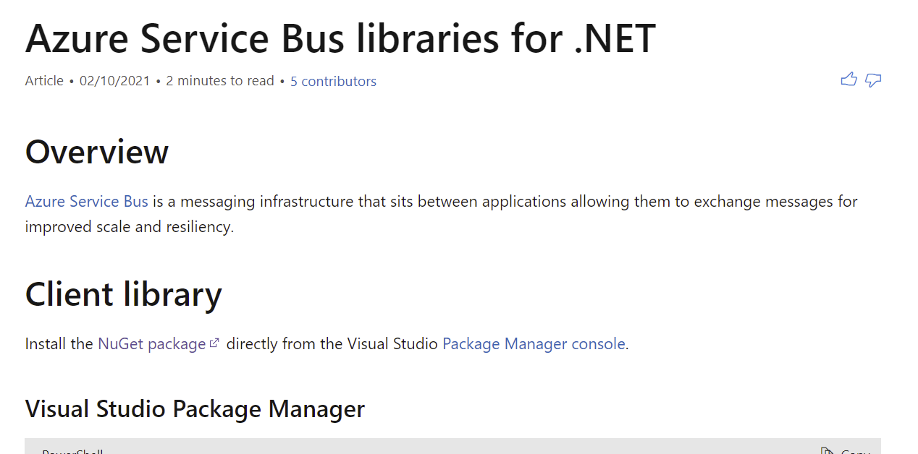
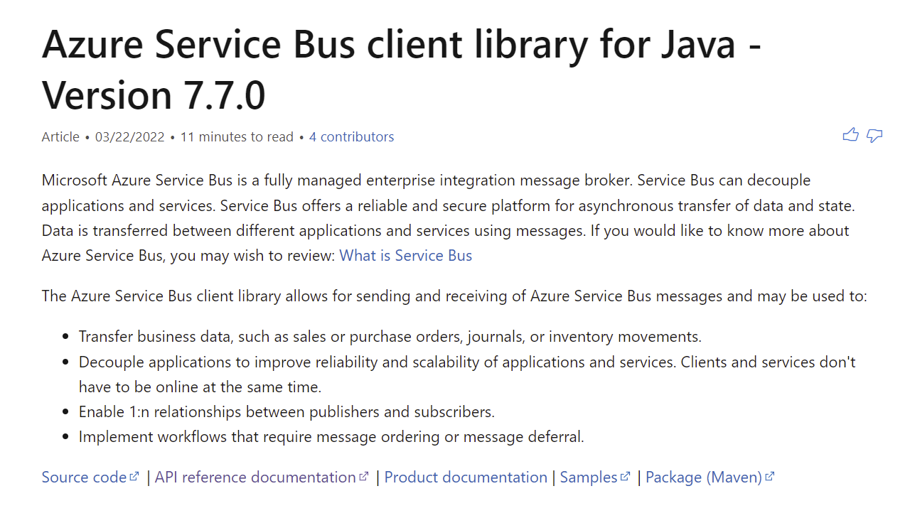
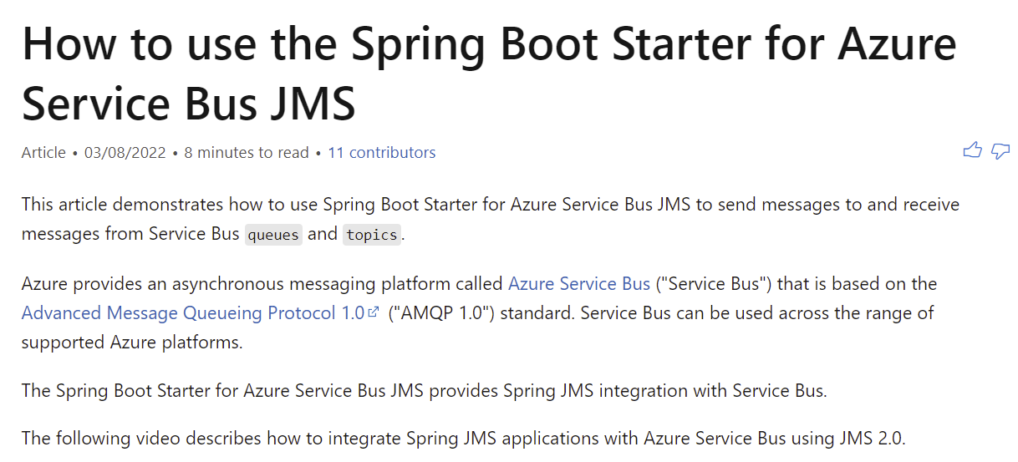
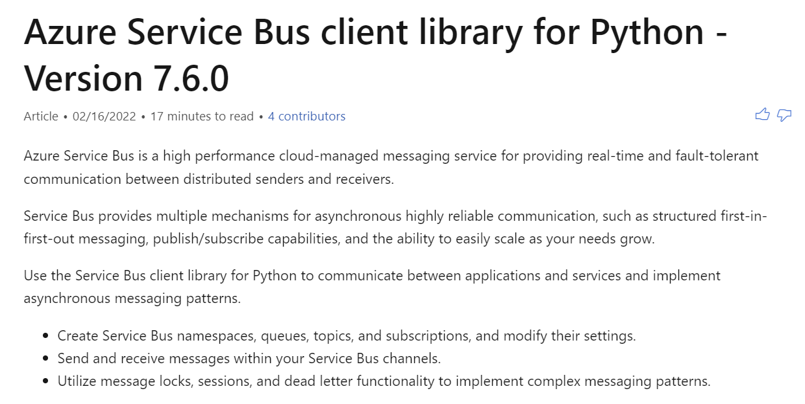
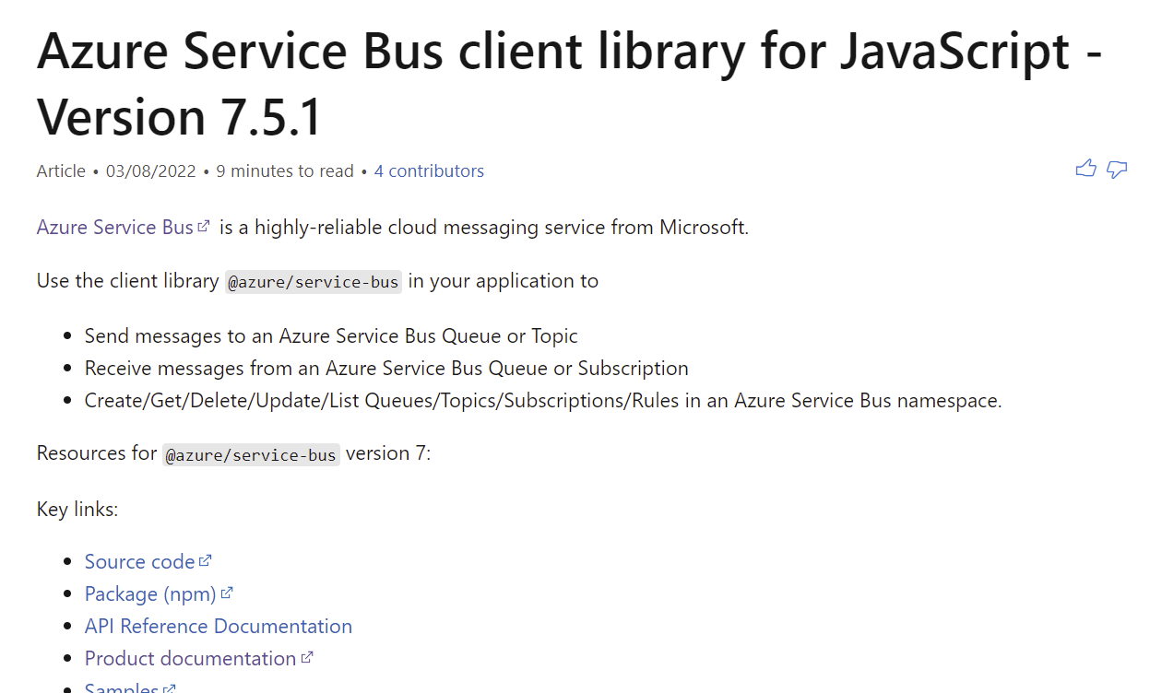
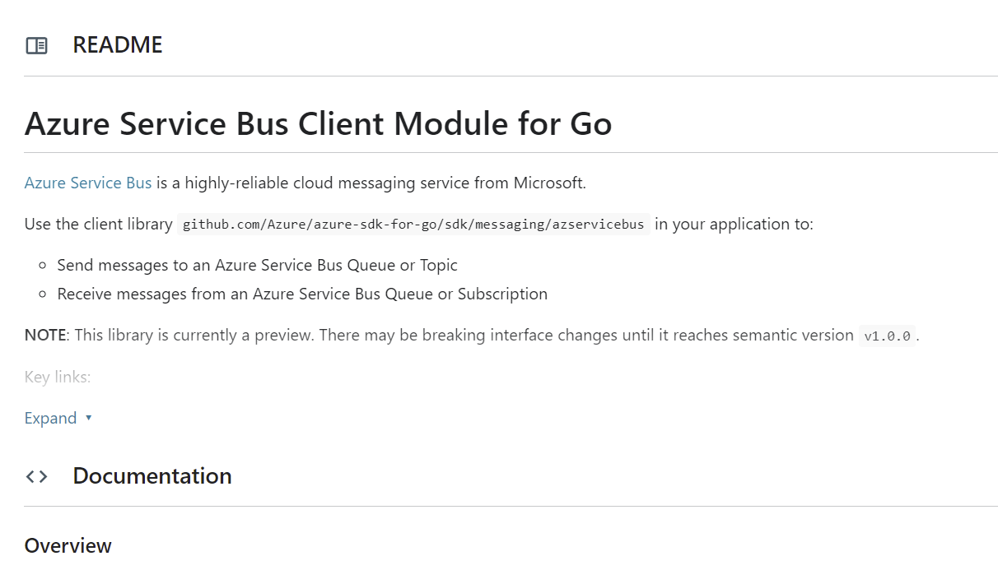
SDK Support: Azure SDKs
.NET
Java
Java Spring Boot
Python
JavaScript/Typescript
Go

Slide 15
Compatible Generic AMQP 1.0 Clients
Client Stack | URL
Apache Qpid Proton-C (Go, Python, Ruby, C++) | https://qpid.apache.org/proton/
Apache Qpid Messaging API | https://qpid.apache.org/components/messaging-api
Apache Qpid Proton-J | https://qpid.apache.org/proton/
Apache NMS AMQP | https://activemq.apache.org/components/nms/providers/amqp/
AMQP .NET Lite (all variants of .NET, incl. Nano & Micro) | https://github.com/Azure/amqpnetlite
Azure AMQP (our own server stack) | https://github.com/Azure/azure-amqp
Azure uAMQP C (Python, PHP) | https://github.com/Azure/azure-uamqp-c https://github.com/Azure/azure-uamqp-python
Rhea (NodeJS) | https://github.com/amqp/rhea
Go AMQP | https://github.com/Azure/go-amqp
Vert.X AMQP Client | https://vertx.io/docs/vertx-amqp-client/java/

Slide 16
Architecture
Azure Service Bus Deep Dive
Internal Architecture
Protocols
Performance Metrics

Slide 17
Logical Architecture
Azure Portal
3-tier architecture: Networking, Messaging, Storage
Azure Resource Management API
AMQP 1.0
SBMP (phase-out)
HTTPS / WebSockets
Connection Management
IP Filtering, VNET/PEP
Transport Level Security (TLS)
Authorization Handling
Entity Management
HTTPS / WebSocket Protocol
AMQP 1.0 Protocol
SBMP Protocol
Azure Active Directory
Gateway
AMQP
Log Management / Placement
Volatile State Replication
Sequencing & Timestamping
Indexing
Message/Session lifecycle
Pending request tracking
Transaction handling
Subscription rule handling
Forwarding
At-Rest Encryption (CMK)
Premium Messaging Units (MU) buy isolated capacity at this layer
Backend (Broker)
(RPC)
HTTPS
Binary Log Data Store
Index Store
At-Rest Data Replication
Storage

Slide 18
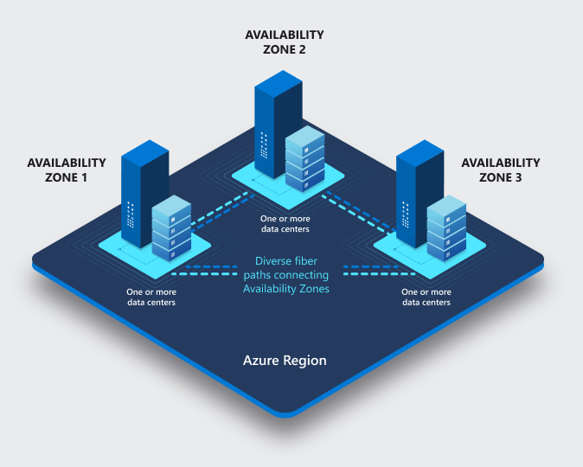
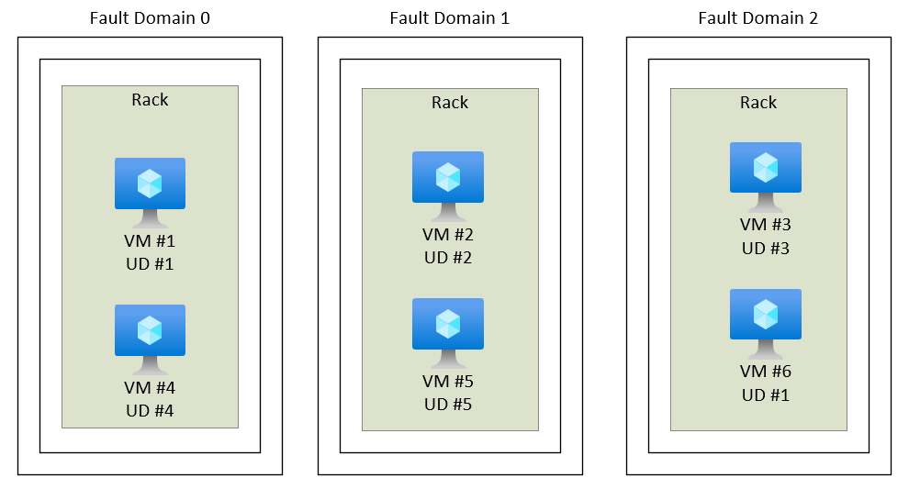
Fault Domains & Availability Zones
High-Availability starts at the physical reality
Fault Domain Placement: Cluster VMs are spread across at least 3 fault domains such that the loss of a rack or network poses no availability risk. Recovery from a fault domain failure is fully automated and the system maintains SLA.
Availability Zones Placement: Each cluster spans three availability zones and maintains SLA without any tolerance for data loss when one or two zones fail.

Slide 19
Backend and Gateway Clusters
Logical Architecture meets Placement
Process Container
Process Container
Process Container
Process Container
Process Container
Process Container
Process Container
Process Container
Process Container
Process Container
Process Container
Process Container
Process Container
Availability Zone 2
Availability Zone 3
Azure Service Fabric (SF) – Leader election (who owns what?), leader lookup, process placement and activation
Availability Zone 1
Fault Domain 1
Fault Domain 2
Fault Domain 3
Fault Domain 1
Fault Domain 2
Fault Domain 3
Fault Domain 1
Fault Domain 2
Fault Domain 3
VM1
VM3
VM5
VM7
VM9
VM11
VM13
VM15
VM17
VM2
VM4
VM6
VM8
VM10
VM12
VM14
VM16
VM18
Azure Virtual Machine Scale Sets (VMSS) – VM Placement/Deployment & Networking (SLB)

Slide 20
Backend and Gateway Clusters
Principles
Everything is automated. There's no manual intervention in placement of VMs or processes or workloads.
Each cluster has a well-known number of virtual machines. We don't use auto-scaling with VMs. We may (rarely) choose to initiate scale up/down to a different level.
Process placement and servicing/upgrade cycles are controlled by Azure Service Fabric.
Allocation of namespaces to clusters are based on well-established heuristics (Standard) or deterministic capacity limits (Premium).

Slide 21
Gateway and Backend
Azure Portal
Workload placement
Azure Resource Management API
AMQP 1.0
SBMP (phase-out)
HTTPS / WebSockets
Gateway
Azure Active Directory
Process Container
Process Container
Process Container
Process Container
Process Container
Process Container
Process Container
AuthZ delegated to AAD
Service Fabric Placement – Stateless Gateway Processes
VM1
VM3
VM5
VM7
VM9
VM11
VM13
VM15
VM17
AMQP
Entities are managed by the gateway layer
Workload placement in the gateway is done by the load balancer (quasi randomly) and accumulated state is managed for the duration of the link lifetime.
The gateway looks up the backend owner of an entity from SF for routing.
Backend
Process Container
Process Container
Process Container
Process Container
Process Container
Process Container
Process Container
Service Fabric Placement – Stateful Backend Processes
VM2
VM4
VM6
VM8
VM10
VM12
VM14
VM16
VM18
Workload placement in the backend is done by SF leader election, choosing a primary and designated secondary processes for owning an entity. Any required failover from primary to secondary is instant and automatic. Idle entities are unloaded.

Slide 22
Backend: Service Bus Premium.
Log Management / Placement
Volatile State Replication
Sequencing & Timestamping
Indexing
Message/Session lifecycle
Pending request tracking
Transaction handling
Subscription rule handling
Forwarding
At-Rest Encryption (CMK)
Workload placement
Entity ownership is mapped to the process(es) associated with a namespace.
Broker Process (4MU)
QM
QM
QM
QM
QM
QM
QM
QM
Memory is exclusively reserved for a broker process.
Cores are exclusively mapped to a broker process.
Broker Process (2MU)
QM
QM
QM
QM
QM
QM
QM
QM
Designated secondaries in different fault domains and AZ reserved for failover
CPU Cores L-Series
Memory Allocations
1
2
3
4
1
2
VM6
Backend
Process Container
Process Container
Process Container
Process Container
Process Container
Process Container
Process Container
Service Fabric Placement – Stateful Backend Processes
VM2
VM4
VM6
VM8
VM10
VM12
VM14
VM16
VM18

Slide 23
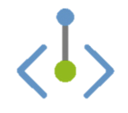
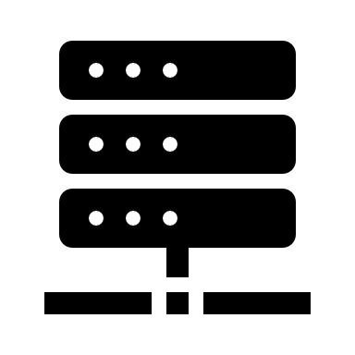
Networking Features
Firewall, Virtual Network Integration with Private Endpoints
Each cluster has a single public load-balancer IPv4 address. The address is generally stable and will very rarely change. But: use DNS firewall rules on your namespace.
AMQP 1.0 w/ TLS
SBMP (phase-out)
HTTPS / WebSockets
CNAME clemensvams.servicebus.windows.net
Namespace names alias the cluster DNS name. SB relies on that hostname to identify the namespace tenant and it can therefore not be further aliased.
Client-Side Firewalls & Proxies
WebSockets AMQP tunneling allows port 443 firewall traversal.
Customer Virtual Network: 10.0.0.0/8
Subnet 1: 10.1.1.0/24
Gateway
ns-sb2-prod-am3-403.cloudapp.net
52.236.186.64
Private Endpoint 10.1.1.42
VM 10.1.1.28
IPv6 SE
TLS 1.2 is the default. All current, supported clients use TLS 1.2 and all traffic generally uses TLS. Legacy clients are still permitted to use TLS <1.2. TLS is terminated at the gateway VMs.
Each cluster has an Azure-private "IPv6 Service Endpoint" address for private endpoints.
Common, namespace-level IP filter and VNet/PEP firewall policy enforcement on each VM.
VM1
VM3
VM5
VM7
VM9
VM11
VM13
VM15
VM17
Relay deployments: Each VM also has a public IP address.
g{0}-prod-am3-002-sb.servicebus.windows.net

Slide 24
Networking Features
Service Bus namespaces can be attached to one or more virtual networks and the public IP address space concurrently and act as safe "Layer 7" (app-level) routers.
Customer Virtual Network: 10.1.0.0/16
Subnet 1: 10.1.1.0/24
Public Network
Service Bus Namespace
Customer NAT
Private Endpoint 10.1.1.42
VM 10.1.1.28
Filter
Topic
Client 192.168.1.2
Filter
Customer Virtual Network: 10.2.0.0/16
Subnet 1: 10.2.1.0/24
Private Endpoint 10.2.1.23
VM 10.2.1.56

Slide 25
Authorization
Azure Active Directory RBAC and Shared Access Signatures (SAS)
Service Bus has two authorization models.
SAS (Local): Simple model for external clients that cannot use Azure Active Directory for any reason.
Very simple. Rights at namespace or entity scope: "Send", "Listen" (Receive/Subscribe), "Manage"
No accounts. 12 named rules per scope, each rule has a key. Rules combine a set of rights.
HMACSHA256 signed tokens are issued using name and key and passed to the service.
Tokens can be issued in the client or by some security token service holding the key
Can be turned off via the portal on the overview page under "Local Authentication"
AAD RBAC: Integrated Azure identity model, also for service-level integration (managed identity)
Very detailed, operation-level permission set that can be assigned to roles
Several standard control- and data-plane roles (like Data Owner, Data Sender, Data Receiver)
Roles can be assigned at the namespace and entity level

Slide 26
Authorization
Azure Active Directory RBAC and Shared Access Signatures (SAS)
A
B
Client
Client
SAS Token
Custom Token Service
Identity Token
1
Rule / Key
Rule / Key
AAD
Identity (SSO)
2
Service Access
3
AuthZ Policy Engine
SAS policy check is performed against the namespace and entity rule set and verifies the token with the stored signing key for the rule.
Service Access Token
AMQP 1.0
4
AMQP 1.0
HTTPS / WebSockets
HTTPS / WebSockets
Service Bus Gateway
Service Bus Gateway
Permissions Cache
Entity policies

Slide 27
Performance and Reliability
Throughput:
Service Bus Standard has a soft throttle at about 500 msg/sec per namespace
1000 credits per second, each send and receive operation counts one credit.
Service Bus Premium is only limited by compute and memory (MU) as well at I/O caps
One log (a single queue) can handle about 10 MB/sec data I/O combined (5000 msg/sec @ 1kB)
More features, more CPU and memory use, less throughput.
Reliability:
Monthly global uptime (are endpoints reachable?): 100%
Monthly global reliability (are operations succeeding?): > 99.995%

Slide 28
Azure Service Bus
Platform-as-a-Service Queue and PubSub Message Broker
Fully managed: You use the features, Azure deals with everything else
JMS 2.0 and AMQP 1.0 standards compliant
Polyglot Azure SDK and cross-platform client support
Industry-leading reliability and availability

Slide 29
Q&A
That was a lot, wasn't it?

